Slide 1

PUB SUMMIT
ARE 2026
PAYMENT METHOD REVIEW
Simon Barff
MANAGING DIRECTOR - CLMS

Slide 2
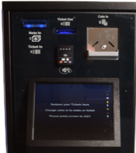
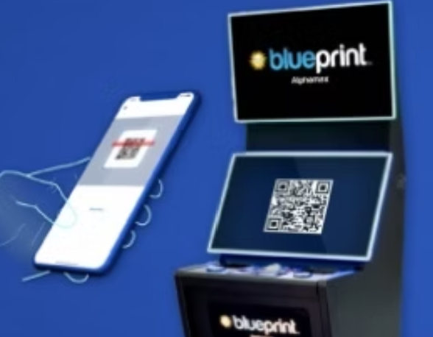
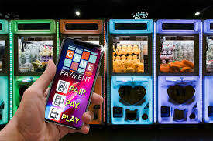




PAYMENT METHOD REVIEW

Slide 3

INTRODUCTION
Contactless Proliferation
Delivering New Opportunities
Contactless pool variance between supplier offer
Regional variances on % contactless
Charges and Fees
Contactless unit providers
AWP app usage
App fees v retained app profit
Other Opportunities
Notes:
WE NOW HAVE 39% OF ALL MACHINES BEING OPEARTED HAVE SOME FORM OF ELECTRONIC PAYMENT AVAILABLE.
31% OF ALL AWPS NOW ALSO HAVE APP PLAY ENABLED

Slide 4

PAYMENT METHOD REVIEW % EFT BY PRODUCT TYPE

Slide 5
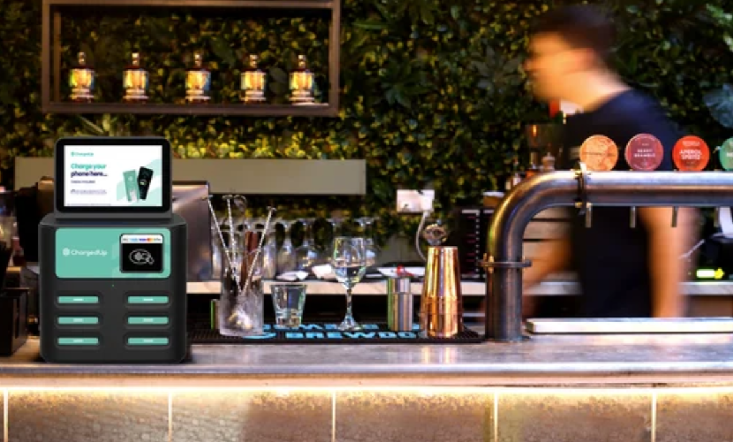

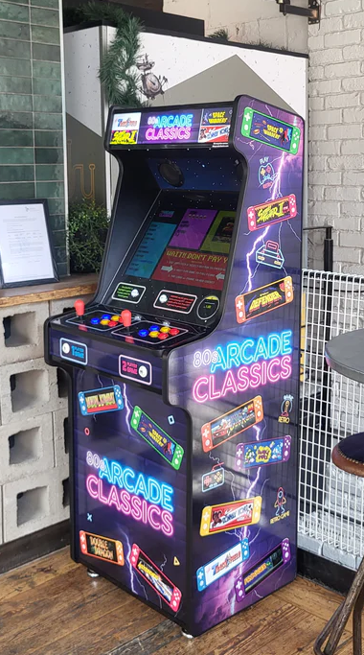
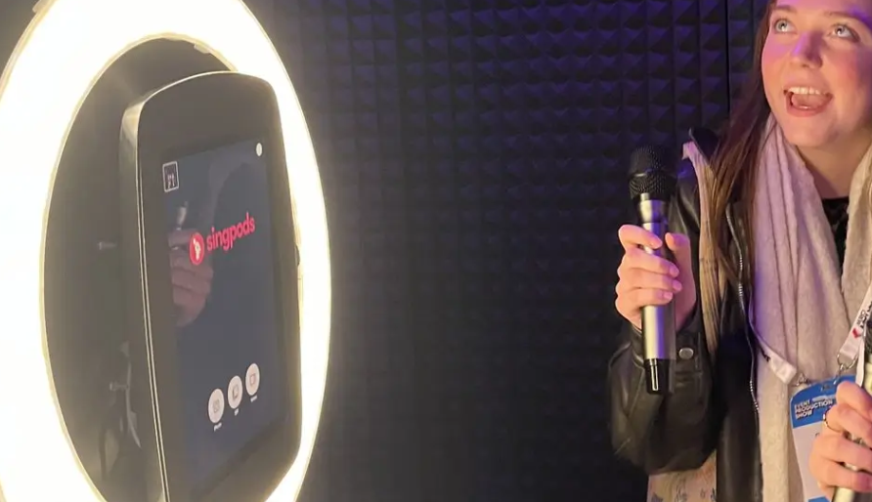
New Products TO PAY TO PLAY

Slide 6
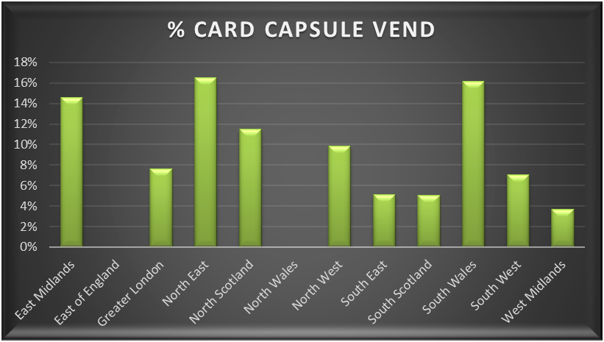
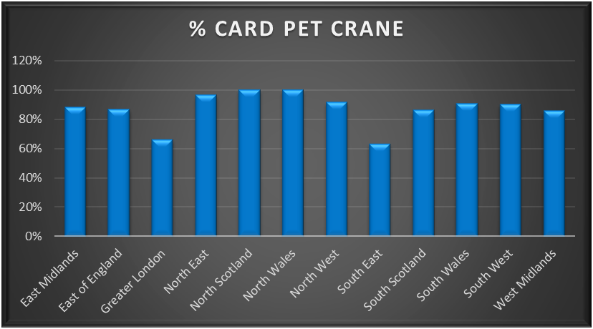

£ INCOME LEVELS FROM OTHER PRODUCT TYPES
Notes:
PET CRANES ARE HAVE NUANCES IN THAT THE ARE SPLIT BY SUPPLIER AND AS SUCH THE SWAG OFFER COULD BE DISTORTING THE FIGURES
ONLY 2 JUKE BOXES HAVE CARD ONLY SO NEED TO BE DISCOUNTED AS A MEASURE BUT THE APP PLAY V CARD AND CASH IS TELLING, ALBEIT THER CHARGES FOR APP PLAY HAVE SEEN A SIGNIFICANT INCREASE RECENTLY

Slide 7
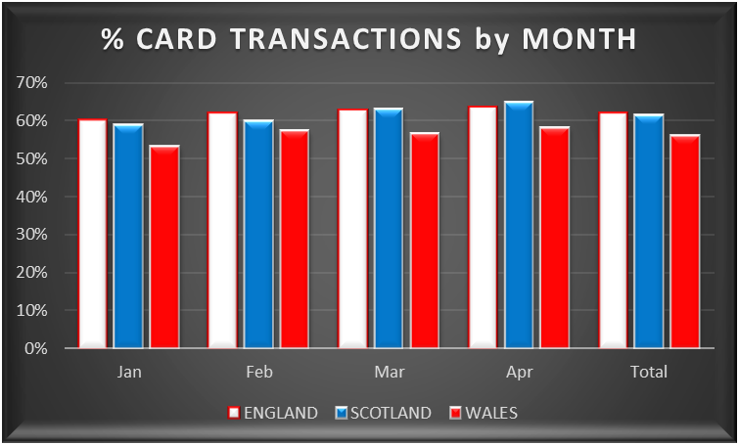
DUAL PAYMENT TRANSACTIONS - POOL
Notes:
ON THIS ONE THER IS A SIGNIFICANT OPPORUNITY FOR INCOME GROWTH ACROSS THE L&T SECTOR.
BARRIERS TO THIS EXANSION ARE LOWER NETT BALANCES & THE RECONCILLIATION OF THE APP CASH. MOST SUPPLIERS ARE DOING THIS WITH CASH SETTLEMENTS AT THE POINT OF COLLECTION WHILE OTHERS ARE SETTLING WITH A DIRECT BANK TRANSFER

Slide 8
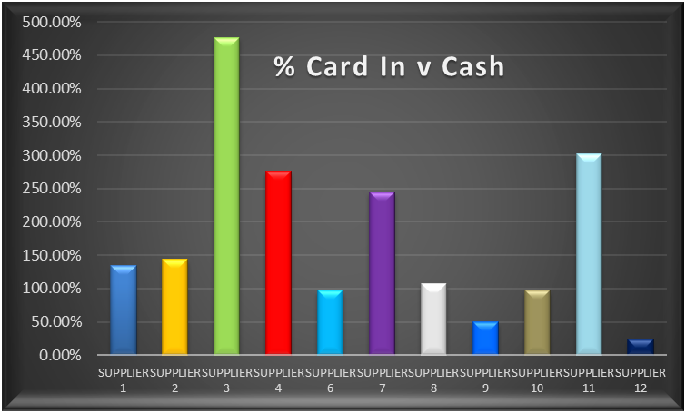
DUAL PAYMENT TRANSACTIONS - POOL

Slide 9
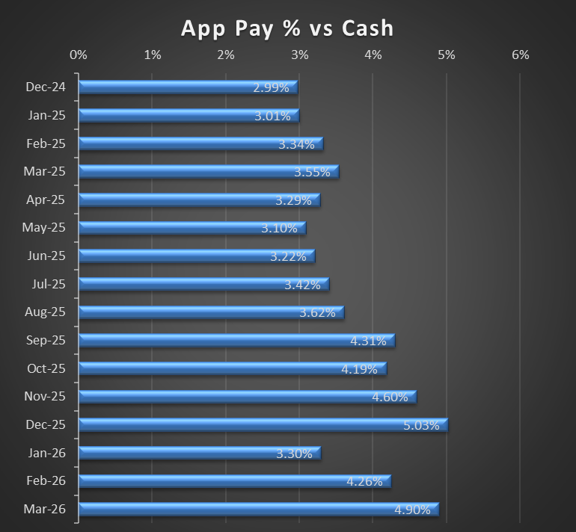
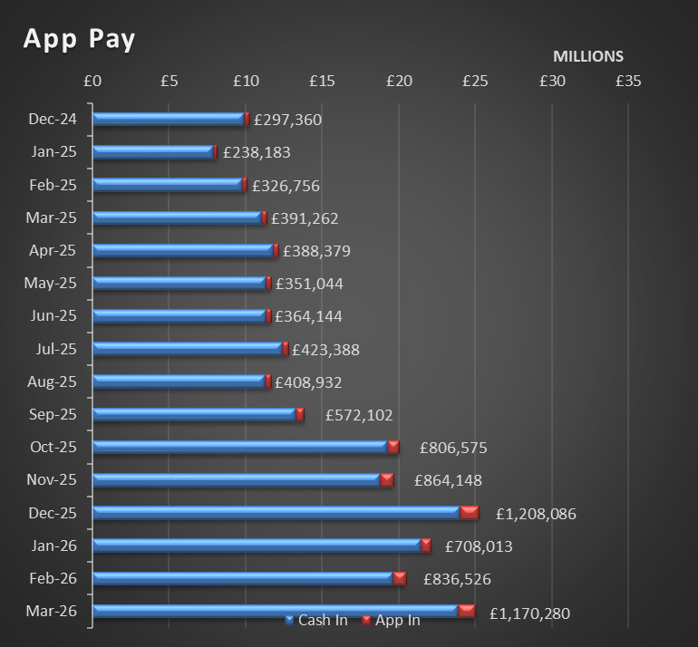
AWP APP PLAY traction

Slide 10
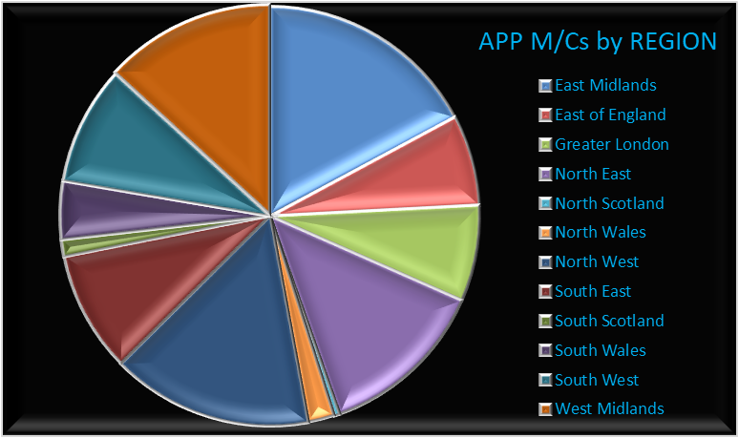
AWP APP PLAY traction – BY REGION
Notes:
REGION SITES East Midlands 796 East of England 321 Greater London 343 North East 602 North Scotland 20 North Wales 94 North West 715 South East 431 South Scotland 61 South Wales 207 South West 423 West Midlands 608 Grand Total 4621

Slide 11
AWP APP PLAY traction
Notes:
REGION SITES East Midlands 796 East of England 321 Greater London 343 North East 602 North Scotland 20 North Wales 94 North West 715 South East 431 South Scotland 61 South Wales 207 South West 423 West Midlands 608 Grand Total 4621

Slide 12
AWP APP PLAY traction
Notes:
REGION SITES East Midlands 796 East of England 321 Greater London 343 North East 602 North Scotland 20 North Wales 94 North West 715 South East 431 South Scotland 61 South Wales 207 South West 423 West Midlands 608 Grand Total 4621

Slide 13
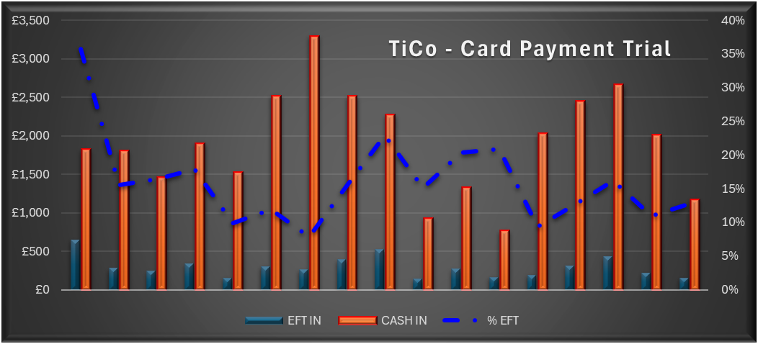
AWP CARD PAYMENT - TICKET IN CASH OUT TRIAL

Slide 14
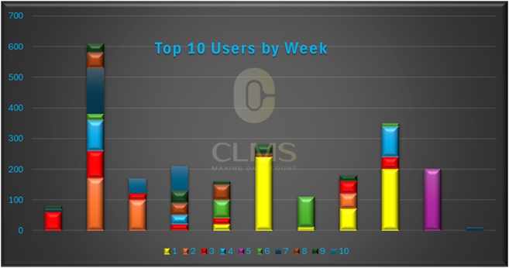
CARD PAYMENT TiCo Trial – 1st 10 wks

Slide 15
THANK YOU
Simon Barff
simonbarff@clms.co.uk

